Slide 1
WisCon Moderator Training
May 2023
Hosted by Gretchen Jones (they/them)

Slide 2
What is a moderator?
Moderators are Conversational Facilitators
A communications officer who maintains clear channels between starships
The music and good vibes that get the conversation going and the party flowing
The one keeping an eye on time and looking out for off-topic panelists, unruly or chatty audience members, and so much more
An invaluable member of the panel who is central to a smooth, engaging discussion!
Notes:
What is a moderator?
Great question! Put simply, a moderator is a conversational facilitator. They’re the grease that keeps the discussion machine going, the communications officer who maintains clear channels between starships.
Like music and good vibes at a party, their job is to get the conversation started and keep it flowing. You’re going to be keeping an eye out for everything from awkward pauses or transitions, a panelist dominating the conversation or getting so far afield you’ve lost sight of what the panel is about, that one audience member with a million questions who doesn’t want to wait to be called on, or potentially even trickier conversational minefields.
While not as visible as the panelists, the role of moderator is invaluable, and it’s central to a smooth, engaging panel discussion. We, quite simply, could not do this convention without mods!

Slide 3
What are a moderator’s duties?
Facilitating conversation amongst panelist prior to the con
Facilitating conversation between panelists during the panel
Managing audience Q&A
Notes:
Moderators have three primary tasks: facilitating conversation amongst panelists prior to the con, facilitating conversation between panelists during the panel, and managing audience Q&A.

Slide 4
Facilitating Conversation Prior to the Convention
Notes:
Moderators have three primary tasks: facilitating conversation amongst panelists prior to the con, facilitating conversation between panelists during the panel, and managing audience Q&A.

Slide 5
Connecting with Panelists
What to do: Prior to the con, reach out to your panelists to start discussing the panel
Why: Panels run more smoothly if everyone is prepared
When: As soon as possible after assignments are finalized ; the sooner the better
How: When the schedule is finalized, panelist emails will be provided
Notes:
What to Do: Leading up to the convention, moderators are expected to reach out to the panelists to prepare for the conversation at the convention.
Why: Panels run more smoothly if panelists and moderators have an idea of what they want to talk about. Panelists are more likely to stay on topic, offer clear and concise information, and be able to prepare quotes or other specific examples if they have time to prepare. Likewise, moderators are better able to direct the conversation, segue neatly between topics, and keep the discussion on point, including managing audience questions, given similar prep time.
When: As soon as possible after assignments are handed out. The sooner the conversation gets started, the better.
How: When moderator assignments are given out, panelist emails will be available in your wiscon.net account by clicking on “my schedule” in the top menu.

Slide 6
Reaching Out Via Email
Introduce yourself (name, pronouns) and ask for preferred name/pronouns if you don’t have them
Determine introduction process for the panel (self or moderator led)
Ask the panelists if they have accessibility needs and forward them to panels@wiscon.net
Suggest or solicit panel structure
Determine the group’s understanding of the panel description
Ask about panelists’ interest in the panel
Determine if specific resources will be cited
Elicit 2-3 crucial topics per panelist
Ask about topics/media to avoid
Discuss meeting up before the panel
Questions or concerns? Contact panels@wiscon.net
Notes:
Introduce yourself, including preferred name and pronouns, and ask if the panelists have preferences for name/pronouns if that information is not available. Feel free to ask for a pronunciation if you are unsure.
Ask if the panelists would prefer to self-introduce during the panel or if they would prefer the moderator introduce them. Ask the panelists if they have any accessibility needs or requests for accommodations, then forward these requests to panels@wiscon.net
Examples might include needing extra space for a mobility device, needing more lead time to speak because they are slow to start, wanting a specific technology aid like computer or tablet for their notes, needing to sit in a specific spot to hear better or alleviate anxiety, or setting aside a spot for a caretaker to sit near them. And many more!
Suggest or solicit panel structure, including how much time for each panelist per question, if and how to solicit and handle audience participation.
Describe your understanding of the panel description and ensure that the panelists agree or would like to modify it in some way. Make sure everyone agrees prior to the con.
Ask the panelists about their interest in the panel topic and what is important for them to highlight about that topic.
Determine if you and/or the panelists are going to cite specific resources.
Elicit 2-3 points that each panelist deems crucial to discuss.
Once you’ve decided on main topics with the panelists, we suggest you make a list of other questions/topics to touch on if there’s time.
Ask the panelists if there are any topics or pieces of media they would like to avoid talking about.
This can be specific to a panelist (“I don’t want to talk about that, but everyone else can”) or a group decision (“That’s too spoilery, let’s avoid it”). Once those boundaries are set, respect them.
Feel free to ask exploring questions like. For example, “You say you don’t want to talk about Andor, are there other Star Wars topics you want to avoid?”
If a panelist mentions something might be triggering, that is a reason to not discuss it at all. If the conversation cannot be avoided (e.g., it’s in the panel description or is central to the conversation), we recommend reaching out to the panelist individually to see if this panel is a good fit for them.
Discuss meeting up before the panel. Make sure that all panelists know to meet in the green room ten minutes beforehand (see below). If a panelist cannot make that timeframe, let them know to meet you in the assigned room and to check the schedule for which room you’re in. NOTE: We suggest touching base with your panelists the day before the panel is scheduled to confirm meeting time and panel location (whether online or in person).
If you have any concerns about one or more of your panelists or feel they may be a poor fit for your panel, contact panels@wiscon.net with your concerns and they can help you out with next steps.

Slide 7
Meeting Up Before the Panel: In Person Mods
Meet your panelists in the Green Room 10 minutes before the panel starts and get name tents.
If you can’t make it to the Green Room, let panelists know ahead of time and feel free to pick up the name/panel tents early or designate a panelist to do it for you.
If a panelist(s) is running late, let someone in the green room know when you leave for the panel room
Go to the assigned room and make sure microphones are working and distributed evenly
Notes:
MEETING UP JUST BEFORE THE PANEL
In-Person Moderators
Unless it has been otherwise agreed, meet your panelists in the green room ten minutes before the panel and get the name tents.
If you can’t make it to the Green Room, let panelists know ahead of time and feel free to pick up the name/panel tents early or designate a panelist to do it for you.
If panelists don’t show up, give them a couple of minutes before leaving, and make sure to let someone in the green room know that if panelists show up there to direct them to the assigned room.
Go to the assigned room and make sure microphones are working and distributed evenly.

Slide 8
Meeting Up Before the Panel: Online Mods
NOTE: Panels are scheduled for “Online Zoom Room 1” or “Online Zoom Room 2”
An unmonitored, non-private Zoom meeting “Green Room” is available
Questions? Head to the #green-room Discord channel
Joining the Zoom Call
Everyone will join a regular zoom call
There is no waiting room
There is one link per Online Zoom Room per day, available via the online program
Panelists and mods will receive a link via email
Notes:
Online Moderators
You are an online moderator if you panel is scheduled for either “Online Zoom Room 1” or “Online Zoom Room 2”. These panels are taking place entirely via Zoom, so the process will be different from in person
ONLINE “GREEN ROOM”:
If you would like to meet somewhere to talk before the panel begins, there will be an open Zoom meeting “Green Room” available, but that call will be unmonitored (no staff logged on).
If you have any questions, please bring them to the #green-room channel on Discord!
JOINING THE ZOOM CALL:
Panelists, moderators, and audience members will all join a regular Zoom call.
The Online Zoom Room calls will not have a Waiting Room—audience members can freely join any time, and can stay in the call between panels.
There is a single link for each Online Zoom Room for each day. These links will appear in the online version of the program, at https://program.wiscon.net/welcome.php , though you’ll need to be logged into your account to the see the links!
You’ll also receive the meeting information (including links, meeting IDs, and passwords) via email.

Slide 9
Online Mods (continued)
Volunteer Production Assistant
Manages the technical aspects of the call
Manages audience disruptions
Provides time signals
Chat
Will be enabled and it moves fast!
Audience members are encouraged to use the panel’s channels for side conversations
Feel free to take note of points/questions in chat to bring up during the panel or Q&A
Notes:
PRODUCTION ASSISTANT:
Each Zoom panel will have a volunteer Production Assistant on the call, who will manage the technical side of Zoom (starting/ending streams, dealing with any technical issues, coordinating the captioner if there is one on the call, etc.).
They will also deal with any disruptions from the audience (including removing any abusive or harassing audience members), and will provide time signals.
CHAT:
The chat will be enabled, but audience members will be encouraged to use the Discord server for side conversations (to avoid distracting the panelists or other audience members), unless you make an announcement otherwise.
Feel free to make notes of interesting questions you might see in the chat that can be brought up during Q&A or during the panel. (if you have the attention span!)

Slide 10
Facilitating Conversation During the Panel
Notes:
Moderators have three primary tasks: facilitating conversation amongst panelists prior to the con, facilitating conversation between panelists during the panel, and managing audience Q&A.

Slide 11
Getting Started
Start on time
Introduce yourself as the mod and explain any ground rules (including Q&A)
Introduce the panel topic and let panelists introduce themselves/their interest in the topic
Accessibility/Safety notes for in-person panels:
If there are microphones, use them
Keep your masks on
There may be a noisy air filtration box in the room, if you turn it off remember to turn it on again when you leave
Notes:
Getting Started
Start the session on time.
Introduce yourself as the moderator and explain your ground rules (if, how and when the audience can participate, timing for the session, snapping instead of clapping, etc).
Introduce the panel topic and (unless they ask otherwise) allow the panelists to introduce themselves and explain their interest in the topic.
Feel free to bring your own notes regarding discussion topics, secondary topics, topics to avoid, etc. I usually have mine on my phone, but you can use paper, a laptop, or tablet just as well.
Notes For In-Person Panels:
When microphones are present, use them, and make sure all the panelists do, too.
Some of us do not hear well enough to participate without microphones, and you can't tell by looking who we are.
Please remember to keep your mask on except in between sips of liquid and remind the panelists to do the same. No one should be talking without a mask on during the panel.
As part of our Covid-19 safety, your room may have an air filtration box in it, which may be noisy. If you need to turn it down or off during the panel, please remember to turn it back on after your session ends.

Slide 12
Best Practices
Be Vigilant. Stay alert to and be aware of:
Conversational dynamics
The mood/feel of the room
The ways the conversation can go awry
For white mods, being vigilant is especially important. Part of our role as people of privilege in this space means we must do as much as possible to make BIPOC panelists and audience members feel safe.
This of course applies to other marginalizations and positions of privilege
Notes:
Additionally, if you are white like me, part of our role as people of privilege in this space is to do as much as possible to make sure that BIPOC folks feel safe. Whether they’re panelists or audience members, we want them to know that we respect their voices and will step in to prevent abuse, if necessary. Of course, this also applies to any marginalization vis-à-vis someone with more societal privilege.

Slide 13
Do’s – the MODR Method
Do your best to maintain flow and equitable participation. In short, remember to MODR:
M – Keep the conversation MOVING
O – Keep the conversation ON TOPIC
D – DON’T forget the Clock
R – RESPECT your Panelists
Notes:
Do your best to maintain flow and equitable participation. This is the bulk of your role as moderator, and as a handy pneumonic, remember MODR:
M – Keep the conversation MOVING
O – Keep the conversation ON TOPIC
D – DON’T forget the Clock
R – RESPECT your Panelists

Slide 14
Keep the Conversation MOVING
Try to minimize both awkward pauses and meandering panelists.
You may need to cut off a panelist who has hijacked the discussion.
You may need to move the conversation on to the next talking point if panelist(s) are going too long.
You may need to find a way to perk up a sleepy audience or low-energy group of panelists.
Keep a list of potential secondary topics handy to move things along.
The spice conversation must flow!
Notes:
M – Keep the conversation MOVING
Try to minimize both awkward pauses and meandering panelists.
You may need to cut off a panelist who has hijacked the discussion.
You may need to move the conversation on to the next talking point if panelist(s) are going too long.
You may need to find a way to perk up a sleepy audience or low-energy group of panelists. That list of additional questions you made during planning may come in handy here.
Keep your list of primary and secondary topics handy.
Either may come in useful if the main conversation goes more quickly than expected or there is a lull in audience Q&A. The spice conversation must flow!

Slide 15
Keep the Conversation ON TOPIC
You may need to redirect panelist(s), audience members, or even yourself back to the topic at hand.
Make sure that you’re not allowing personal biases in areas of interest to direct the conversation.
Keep the panel description handy (it’s on the back of the main table tent for the panel) so you can be aware if things are moving too far afield.
If they resist moderation, keep trying. If it becomes a safety concern, contact Safety
Notes:
O – Keep the panel ON TOPIC
You may need to redirect panelist(s), audience members, or even yourself back to the topic at hand if they’ve gotten sidetracked.
Make sure that you’re not allowing personal biases in areas of interest to direct the conversation. This should be about what the panelists want to discuss.
Keep the panel description handy so you can be aware if things are moving too far afield. Conveniently, it’s printed on the back of the main table tent for the panel, this is the one with the panel name on it.
If a panelist resists being moderated, keep trying (with increasing firmness) and feel free to interrupt if they are truly becoming disruptive.
Example, “We’ve heard a lot from you, I’d like to hear from [other panelist].” Or, “That’s getting too far afield and we really need to move on.” Or, in extreme, “I need to cut you off right now because this is becoming disruptive. If I need to, I will contact Safety.”
If they veer into abuse or you are concerned about safety, designate someone to contact Safety to have them removed from the panel.

Slide 16
DON’T Forget the Clock
Keep track of time, especially if you plan on Q&A at the end.
You may need to remind panelists or the audience how much time is left to keep the conversation moving or wrap things up.
Notes:
D – DON’T forget the clock
You will need to keep track of time so that if you planned Q&A, there is enough time for that at the end.
You may need to remind panelists or the audience how much time is left to keep the conversation moving or wrap things up.

Slide 17
RESPECT Your Panelists
Make sure ALL panelists have a chance to speak and intervene if someone is being talked over or shut out.
You may need to encourage shy panelists to speak, but if they signal discomfort, back off.
Respect the panelists boundaries.
Don’t force them to discuss what they don’t want to, no matter what the reason.
If you write up a “do not discuss” list prior to the panel, stick to it.
Let the panelists shine.
Keep interjections to a minimum and on topic.
Your role might not be as flashy, but it’s ESSENTIAL to an excellent, engaging panel!
Notes:
R – RESPECT your panelists
Make sure all the panelists have a chance to speak.
Gender, race, class, and ability are some factors that influence participation styles. Be aware of power dynamics and intervene as necessary when panelists or audience members exercise privilege to dominate the conversation.
This is especially important in panels discussing identities and privilege, but it can happen anywhere. Just because your panel isn’t about gender doesn’t mean gender isn’t influencing the conversation!
You may need to encourage shy panel members to share their thoughts.
HOWEVER, if you get signals that a panelist is uncomfortable with your level of gentle encouragement, BACK OFF. Some people freeze in situations like these and calling them out repeatedly may make them, and the audience, even more uncomfortable. Use best judgment to balance making space for them and not making them feel awkward or called out.
Respect the panelists’ boundaries.
If there are topics or pieces of media that the panelists do not wish to discuss, for whatever reason, do NOT force them to discuss it.
It could be triggering, they may want to avoid spoilers for the audience, or they could not feel qualified. Regardless, moderators should never put a panelist on the spot by explicitly asking them to discuss something they have expressed resistance about.
If you have elicited a list of “do not discuss” topics prior to the panel, do not try to bring one up at the panel.
If a topic comes up at the panel and one of the panelists hints at or explicitly says, “I don’t want to discuss that, let’s move on”, move on. Do not press them to discuss it.
Let the panelists shine.
Feel free to offer encouraging comments, especially for shy panelists (“That’s a really great point”, or “Wow, I’d never thought of it like that”) or cover for a panelist struggling with words (“What I hear you saying is….is that correct?”), but otherwise keep interjections to a minimum.
Your role may not be as flashy as the panelists, but believe me, it is every bit as essential to a good panel!
I’ve been a panelist at multiple conventions and a moderator can make or break a panel as much as the panelists can, sometimes even more so. Trust me, a good moderator is *chef’s kiss*

Slide 18
Donts
Don’t dominate the conversation.
Don’t focus on your own work or writing at the expense of the panelists.
Don’t veer wildly away from the panel description.
Don’t change the structure or content of the panel at the last minute.
Mess up? Don’t worry, we’ll discuss handling moderator missteps later.
Notes:
Don’t dominate the conversation.
Moderators are not participants in the same way panelists are and this is not an opportunity to be a “fourth panelist”. You’re the coach on this team, you want to make sure that the panelists are set up to engage each other and the audience in their conversation. This is their platform to speak, your job is to ensure they have the best chance to do that as possible.
Remember, your job is to facilitate, not dominate.
If the panel is thin, you may need to pick up some conversational slack, but this should be agreed upon with the other panelists beforehand.
Don’t focus on your own work or writing at the expense of the panelists.
Again, your role is to highlight the panelists. If your work happens to come up in conversation, that’s fine. However, being a moderator is not free advertising for yourself or your work.
Don’t veer wildly away from the panel description.
Rabbit trails happen, we get it. Still, one of the moderator’s jobs is to ensure that the panel follows the framework of the panel described in programming as much as possible. The audience came to the panel described for a reason. We don’t want the audience to feel they were misled by false advertising.
If you don’t like how the panel description is written, make that part of the conversation! The panelists are welcome to interrogate how the panel is written or even the premises behind how the description is written.
Don’t change the structure or content of the panel at the last minute.
When you and the panelists determine structure leading up to the convention, stick to it.
For example, if you’ve decided on ten minutes of audience participation after the main panel discussion, do not decide last minute to allow audience questions throughout the panel.
Or, if you and the panelists decided on three main topics, don’t add a fourth or spring a new question on them the day of.
If you come up with other questions you think might be interesting, keep them in your back pocket for lulls in the conversation, as mentioned above.
Again, you want to facilitate conversational flow between the panelists as much as possible. Last minute changes are disruptive to everyone.

Slide 19
Moderating as a Co-Panelist
When might this happen?
If there is one other person in the panel besides you, you are automatically a co-panelist
If there are two other people in the panel, you may be a co-panelist if you all agree
Best Practices
Take extra care to not dominate the conversation
Take extra care to ensure all the other panelists get a chance to speak (especially if there is a element of privilege)
Discuss your dual role with the panelists beforehand
Make the audience aware of your dual role when the panel starts
Notes:
Moderating as a Co-Panelist
On some understaffed panels, you may be serving a both a moderator and a panelist.
If there is only one other person besides you on the panel, you are automatically a co-panelist.
If there are two other people on the panel, you may serve as a co-panelist, but everyone must agree to this beforehand.
So, if you discover in your panel assignments that you are one of three people on the panel (a mod and two panelists), make sure to discuss whether or not you want to fill this dual role before the con begins.
In these situations, it’s even more important to make sure that you don’t dominate the conversation and make space for all the panelists to speak, especially if there is any element of privilege.
We recommend that when you communicate with your panelists in advance of the panel, you specifically discuss how you will be managing your dual roles as a panelist and a moderator.
We also recommend making the audience aware of your dual role when you introduce the panel. Since part of the moderator’s role is managing the audience, it benefits you if they know in advance that you’re filling that role even as you also fulfill the role of a panelist during the discussion.

Slide 20
Moderating Round-Table Discussions
As with in person discussions, it is important to remember to MODR:
Keep the conversation MOVING
Keep the conversation ON-TOPIC
DON’T forget the clock
RESPECT your panelists – in this case, everyone else in the room
If you use any of the following suggested methods to facilitate conversation, make sure to explain them to the room when you start.
Notes:
Most of what we’ve talked about applies to round-table discussions as well. You still want to remember to MODR.
Keep it MOVING
Keep it ON TOPIC
DON’T forget the clock
RESPECT your panelists, aka, everyone else in the room!

Slide 21
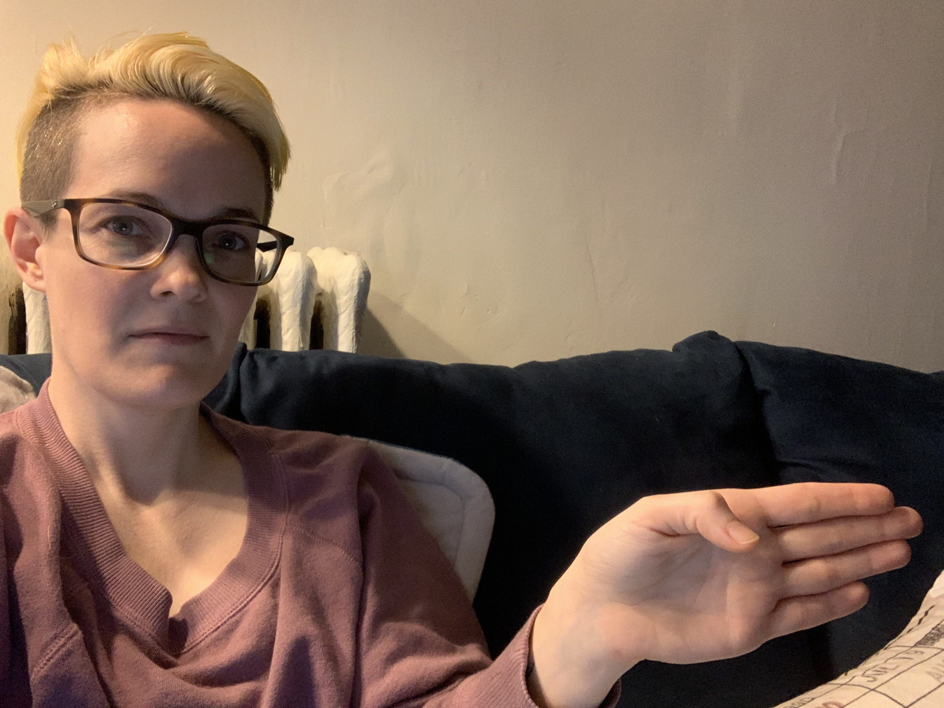
Hands-Up! A Guide
We suggest everyone who wants to speak raise their hand.
If someone wants to add to what the current person is saying, their hand should be horizontal, pointing at the person speaking.
Notes:
With lots of voices in the room, it can make it tricky to keep the conversation under control. We have a method that will hopefully help you to keep the conversation moving and on topic while giving a chance for as many folks as possible to speak. It might be helpful to explain this method at the beginning of your panel, it’s fairly short and sweet so it shouldn’t take up too much panel time.
Hands up! A Guide to Round Table Discussions
Folks who want to speak in a round table should raise their hands.
The way they raise their hands indicates if they want to add to what someone is saying or change the subject.
If they want to add to what the current person is saying, their hand should be horizontal, pointing at the person speaking. Think they’re trying to shake that person’s hand.
For example, say panel topic is “Star Wars Ladies and Why We Love Them” and someone is discussing Princess Leia as an anti-imperialist figure. If I wanted to expand on that by discussing her role as rebel leader in the OT vs as a general in the ST.

Slide 22
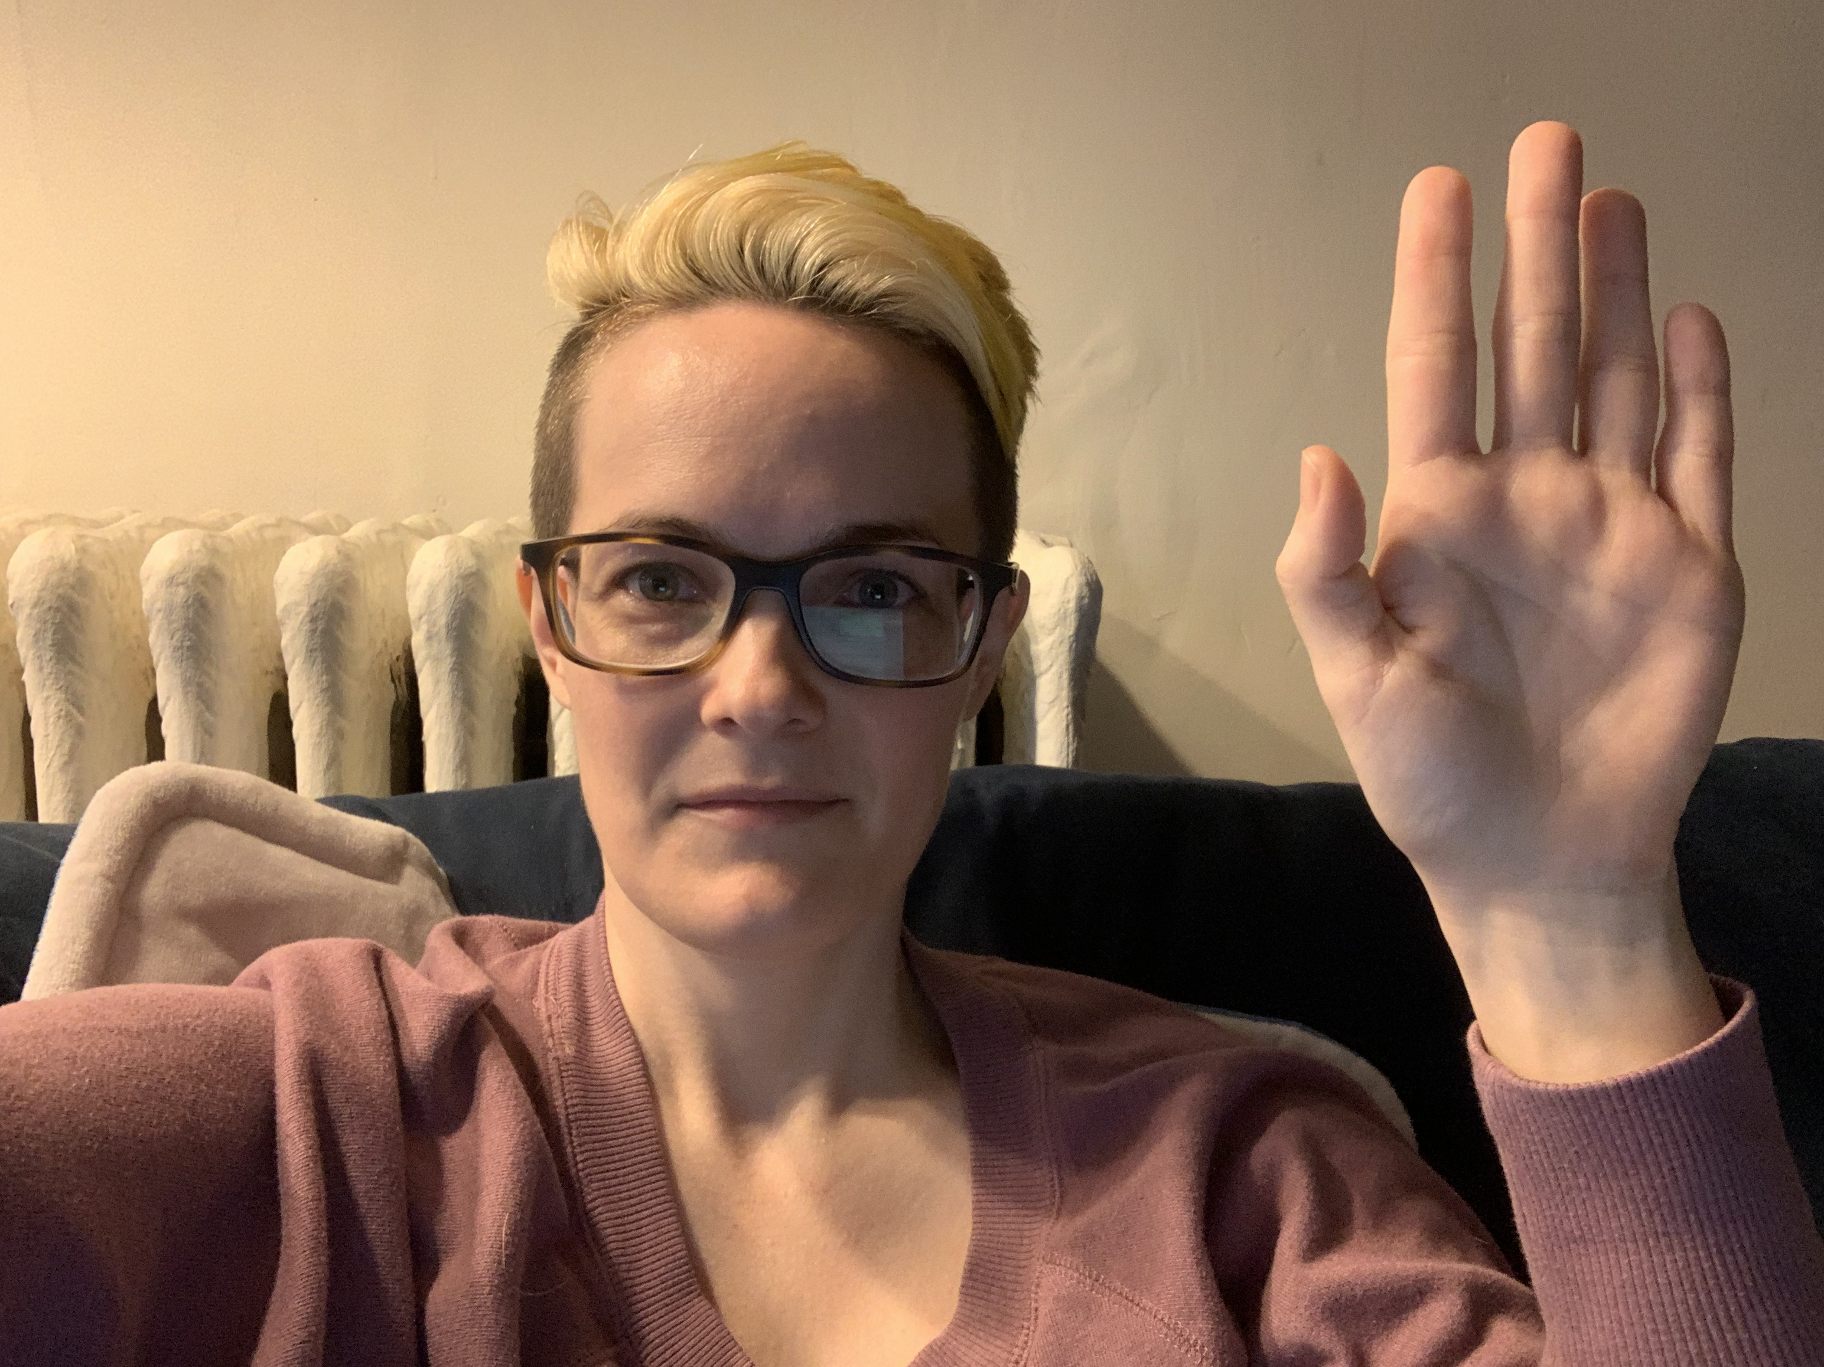
Hands-Up! cont’d
If someone want to change the subject, their hand should be raised vertically.
We suggest folks snap instead of clap to express appreciation or agreement
Notes:
If they want to change the subject, their hand should be raised vertically.
In that same Star Wars Ladies panel, if someone wants to move the conversation to talking about how we absolutely deserve Doctor Aphra and Sana Starros on the big screen instead of Leia as an anti-imperialist figure.
With this method, you, the moderator, have a clear indication of what is on topic and what is a new topic, helping you to prevent the conversation from going in circles.
We also recommend that if folks want to show appreciation for a particularly insightful or delightful remark, they snap rather than clap. It’s less intrusive and better for folks with sensory sensitivities.

Slide 23
Other Round-Table Best Practices
Try to prioritize folks who raise their hands first
Exception 1: You may want to prioritize staying on topic versus a new topic
Exception 2: You may want to avoid letting someone dominate the conversation
Use best judgment and read the room when it comes to staying on one specific topic
Feel free to propose rules for what can/not be discussed
Are spoilers okay?
How do you want to handle triggering topics?
Feel free to interrupt if someone is being disruptive or harmful
Contact safety or anti-abuse if things get out of hand
Notes:
Other Round Table Best Practices
All else being equal, try to prioritize folks who raise their hands first.
Exception 1: you may want to choose someone who raised their hand third or fourth if it is on topic vs the first three who want a new topic.
Exception 2: If someone is dominating the conversation, even if they’re first to raise their hand, choose someone else. You are welcome to say, “I’m so glad you have so much to contribute, I think it would be great to hear more voices.”
How long you stay on a particular topic is up to you and the mood of the panel. If everyone is cool talking about Princess Leia for an hour, that’s fine! Use your best judgment and read the room.
Feel free to propose rules for the panel of what can or cannot be talked about.
Are spoilers okay?
What about potentially triggering topics? Should they be avoided, or should folks provide a warning?
Feel free to interrupt and move the conversation along is someone is being abusive or otherwise disrespectful.
If things get truly out of hand, designate someone to go find a member of the safety or anti-abuse team and then report what happens to the appropriate Con personal after the panel.

Slide 24
Handling Moderator Missteps
Be Humble. Mistakes happen, even to the seasoned among us
What can go wrong?
Messing up a panelists’ or audience member’s name or pronouns
Talking over or interrupting a panelist or audience member
Saying something offensive or hurtful (regardless of intention)
Others?
Notes:
First, I want to give a huge shoutout to an essay Naomi Kritzer wrote on how to deal with a panel gone wrong. Most of the handling unruly audience members and portions of this section are cribbed from that essay, so she was instrumental in outlining how to handle such sticky situations.
Be humble. No matter how aware we are of the intersecting or overlapping power dynamics of gender, race, class, ability, etc, us moderators may be the ones who mess up. This is even more possible when you’re in a panel where you’re serving as both moderator and panelist.
What kinds of mistakes can happen? These are some of the possible ways that a moderator could misstep during a panel
Messing up a panelists’ or audience member’s name or pronouns
Talking over or interrupting a panelist or audience member
Saying something offensive or hurtful (regardless of intention)
Question for break out rooms: What other ways can you think of?

Slide 25
Name It, Claim It, and Move Along
Listen – hear the person out
Name It – acknowledge what you did
Claim It – apologize with sincerity
Move Along – don’t get stuck in the moment, do your best to gracefully shift the conversation back to the panel
Follow Up – be willing to connect after the panel in order for the person injured to feel heard and respected
Be willing to contact safety or anti-abuse – if the person injured asks for a mediator or to speak with safety or anti-abuse, accept their wishes and contact the appropriate Con personnel
Notes:
Name It, Claim It, and Move Along
Mistakes do happen, What’s important is to acknowledge our misstep, take responsibility for it, and continue to keep the conversation moving. If you want a pithy phrase to help you remember: Name It, Claim It, and Move Along.
Listen. First things first, if someone calls you out, or if someone else is responding to your own admission, it’s vital that you hear them out and truly listen.
Don’t interrupt to justify or explain.
Don’t tone police. Part of humility is being willing to accept critique no matter what form it comes in.
Don’t minimize or dismiss their feelings. Try to truly hear what hurt or upset them, even if it doesn’t make sense to you.
If there is time, ask any clarifying questions you need to make sure that you understand and the person feels heard. HOWEVER, you may need to move the conversation to a follow up after the panel.
Name it: Acknowledge What Happened. Whether we call ourselves out or someone else does, the most important thing we can do is own the critique. This means admitting what you did. For example, “Gosh, I think I just mispronounced your name” Or “You’re right, I did just interrupt you.”
If you have privilege in the conversation (say, you’re a white person who mispronounced a Black panelist’s name), don’t let shame or embarrassment get in the way of taking responsibility. This can be difficult work to do, especially if we are not living up to our expectations of ourselves. These feelings are understandable, and it’s more effective for everyone in the room if we manage them ourselves afterward rather than in the moment.
Claim It: Apologize. In the context of a panel, this should be kept brief but also express sincerity. For example, “I’m sorry that I interrupted you, that was rude of me. Please continue.”
Minimize self-flagellation, explanations, or justification, these can come off as insincere or like you’re avoiding taking responsibility.
Minimize dramatic displays of your own emotional reactions to the event. While they may be sincere feelings, it can feel like an attempt to blame shift or distract from the harm done. For example, the phenomenon of “white women’s tears”.
Move Along: Don’t Get Stuck. When we trip up, it’s easy to get flustered, especially if we feel shame or guilt about what we did or said. It’s perfectly normal to feel these things! At the same time, in the middle of a panel where it is our job to keep the conversation going is not the best time for us to indulge in our own feelings or let our missteps dominate the conversation. That’s not what the audience or panelists came for. This can be tricky, as we do want to make sure to get back to the topic at hand and we don’t want to appear dismissive.
If you’ve done all the above, it should be easier to encourage everyone to get back to the topic at hand.
If someone is getting stuck on the mistake, it might be best to offer to follow later, when you can thoroughly discuss what happened without taking time away from the panel (see below).
Follow Up. Depending on what the mistake was, you need to be willing to follow up with panelists or audience members regarding what happened. This is especially important with panelists where there is an element of privilege (intentional or otherwise) involved, but that’s not the only time. You’ll need to use best judgment to get a sense of when someone might want to be followed up with. And, even if they don’t want a follow up, offering one displays goodwill and a willingness to continue to be humble and listen.
When asking for this, make sure you do so in a gentle and validating way. An example of how to move that conversation might be:
“I would like to know more about how this impacted you so that I can do better next time. I don’t think we have time for that right now, but can I follow up with you after the panel? It’s important to me that I fully hear and understand you.”
Note, if you offer to follow up, make sure you follow up.
It may be necessary to involve the safety or anti-abuse team. If the person harmed asks to involve them, or to involve any kind of mediator, accept it and contact the correct Con personnel.

Slide 26
Name It, Claim It, and Move Along cont’d
Putting it all together, an example:
Context: One of your panelists is discussing their experience with ableism and you respond with a personal anecdote (meant to be a funny transition to a new question) that made them feel dismissed or that you were correcting them.
Here is one way you could respond if they were to call you out:
“If I understand you correctly, the comment I made felt dismissive and inappropriate. Is that correct?”
*Wait for panelist’s response*
“Thank you for telling me. I hear you, and I’m so sorry that I spoke over you about ablism. I’m not sure if we have time in this panel to fully unpack all of what that means to you, but I would like to have that conversation. Can we follow up after the panel?”
Notes:
Putting It All Together. What might all this sound like when you put it all together? Say that one of your panelists was discussing their experience with ableism and you responded with a personal anecdote (meant to be a funny transition to a new question) that made them feel dismissed or that you were correcting them. Here is one way you could respond if they were to call you out:
“If I understand you correctly, the comment I made felt dismissive and inappropriate. Is that correct?”
*Wait for panelist’s response*
“Thank you for telling me. I hear you, and I’m so sorry that I spoke over you about ablism. I’m not sure if we have time in this panel to fully unpack all of what that means to you, but I would like to have that conversation. Can we follow up after the panel?”
Question for breakout rooms: what else might this look like? Try problem solving both a situation like this and what it might look like to respond in this way

Slide 27
Managing Audience Q&A
Notes:
Moderators have three primary tasks: facilitating conversation amongst panelists prior to the con, facilitating conversation between panelists during the panel, and managing audience Q&A.

Slide 28
Overview
Let the audience know when/how it will happen when you introduce the panel
Letting the audience participate during the panel is not recommended, it can be disruptive
If the panel goes long, refer the audience to Discord
During Q&A
Remind the audience to stay on topic, speak loudly, and be succinct
Repeat questions into the mic, or ask the audience member to do so, if necessary
Do your best to maintain flow and equitable participation
Try to include as many different people as possible
Keep an eye on the time
If possible, leave time for panelists to refer folks to their social media
Notes:
As part of your introduction, you should have let the audience know how participation will work (how much time, when, etc).
We do recommend leaving some time at the end for Q&A, even if only 5-10 minutes.
Unless everyone has agreed, letting the audience participate during the panel is not recommended, as it can be disruptive.
If the panel goes long, encourage the audience to go to Discord to continue the conversation in the channel designated for your panel.
When it’s time for Q&A, you might want to provide a gentle reminder to stay on topic, speak as loudly as possible so everyone can hear, and to keep questions as succinct as possible.
You may need to repeat a question into the microphone, or ask the audience member to come forward and speak into a microphone, if the room is large and/or the audience member has a quiet voice.
For online panels, you may want to make a list of questions as you see them come up during the panel. When Q&A starts, read out the audience questions yourself so that everyone can hear them.
As with the panel, do your best to maintain flow and equitable participation.
You may need to cut off an audience member who has raised their hand to ask a question and then tried to deliver a twenty-minute "This is more of a comment than a question...".
You may need to cut off an audience member who jumps in to ask their question before being called on or who tries to interrupt another audience member who is speaking.
Try to get questions from as many different audience members as possible.
Keep track of time, being aware that the room you’re in (whether online or in-person) will likely need to be used afterward so going over will inconvenience that panel.
If there is time, wrap up by allowing the panelists to briefly offer ways that they can be found on social media.

Slide 29
Handling Unruly Audience Members
Set expectations up front when possible – this applies to both panelists and audience members
Interrupt – shut down the problem as soon as possible
Name the problem – be specific and be honest
Allow a response (from someone else) – designate someone you can trust to play this role if necessary
Notes:
HANDLING UNRULY AUDIENCE MEMBERS AND ABUSE
What do you do when you’re moderating and someone in the audience, or (worse) on the panel, decides to take a swan dive into garbage – racism, antisemitism, conspiracy theories, eugenics, whatever? Here are some tactics we recommend.
Set expectations up front when possible.
With panelists prior to the panel - When you send out e-mail to your panelists beforehand, you can ask people if there are topics they’d prefer you to steer away from should they come up – sometimes your panelists will already know where the danger zones are, and you can frame your panel accordingly.
With the panel/audience when the panel starts - Sometimes you’ll be moderating a panel where you can see a problem coming, and sometimes you can do some prevention by setting expectations and ground rules as you are introducing the panel. “We are NOT here today to advocate for eugenics, and anyone who goes in that direction will be asked to stop.” “This is a no-conspiracy-theories zone.” “It is the position of this panel that COVID mitigation is worthwhile and we’re not going to debate that today.”
Interrupt.
Maybe it just did not occur to you that a panel on feminist embroidery would suddenly veer into antisemitic conspiracy theories, but here you are! The first thing to do is INTERRUPT. You want to shut down the person spouting garbage as fast as you possibly can.
This is uncomfortable because we’ve all been taught that interrupting is rude, but it is the most important thing a moderator can do in the moment.
You can start with, “Excuse me” but escalate if you have to: “Excuse me. Nope nope nope! Hey!! EXCUSE ME. I AM GOING TO STOP YOU RIGHT THERE. STOP. STOP NOW. STOP TALKING.” (This can end with “Can someone in the back please go get someone from safety,” if necessary.)
Name the problem.
Be as specific as possible (If you’re in the middle of an adrenaline surge, you may find yourself struggling to come up with the words, but do your best.) “That is transphobic. We are not going to discuss whether transphobia is justified.” “What you said was a racist stereotype and unacceptable at WisCon.” Etc.
If you have to fall back on “That was not okay,” say that.
Allow a response (from someone else).
When someone has just gone wildly off the rails, you will usually see a lot of people who are ready to jump in and tackle it. If you can, call on someone who is sitting close to the front, preferably someone you know will deliver a firm, emphatic response.
If you are moderating a panel where you think there are potential dangers, you may want to find a friend who can fill this role ahead of time.
If you don’t have a pre-designated person, there’s a specific body language that says, “I AM READY TO SMACK THAT PERSON DOWN” that you can look for (typically a very straight raised arm combined with a grim facial expression).
Letting someone else do this has a number of advantages, including that it gives you (the moderator) a minute to collect yourself. Plus, if someone is going to TAKE THAT PERSON TO SCHOOL, feel free to let them talk as long as they want.

Slide 30
Handling Unruly Audience Members cont’d
5. (Optional) allow 1-2 more responses – especially if it makes space for someone from the group harmed to speak
6. Look for lifelines – balance giving the benefit of the doubt with the potential for more harm or justification
7. Redirect – balancing getting back on track with folks being heard
8. Report – ALWAYS contact safety no matter how minor, either by online form or email (safety@wiscon.net)
Notes:
(Optional, depending) Allow 1-2 additional responses.
For a first response, go with someone who has the attitude of “READY TO BE FIRM.” Sometimes, that’s all that’s needed. If you saw a lot of hands shoot up, and picked someone to give the smackdown, and that’s done, and all the hands go down and people seem ready to move on, maybe do that.
But, if people are clearly still upset, look for someone who is a member of whatever group just got attacked. This time, look for more hesitant body language because “that statement really hurt me” tends to look very different from “YOU HAVE MY SWORD,” but also deserves to be heard.
Also note, please do NOT specifically single out anyone from the group harmed if they have not raised their hand or otherwise entered the conversation already. We want to make space for them to speak, but they are not required to speak if they do not feel safe.
Look for ways to offer a Lifeline
If the person who put their foot in it is looking remorseful, and especially if that person is one of your panelists, after allowing a response, you can invite them back into the conversation with something like, “Would you like to reframe that?” Or you can reframe for them: “I think this was coming from a place of [frustration], you were trying to say [something else]?”
However, do not feel obligated to give someone the benefit of the doubt, and in their response they need to keep it short. Also, if you think they’re just going to grab a shovel and dig more, that’s a good reason to not hand them the mic again.
Redirect.
Ideally, having interrupted and responded, you can redirect back to the topic you’re all there to discuss! But depending on how awful it was, consider trying to determine the will of the group. “Let’s talk some more about embroidery!” might be fine, or “How do people feel about getting back to embroidery?” might be better.
If people are very upset, a few more people may need a moment to speak in response. If that takes the rest of the time block, that’s better than the people who were harmed walking out feeling unheard or that their pain was unimportant.
Report.
Get the name of the person if you can and write down some notes about what they said as soon as you can after the panel (your memory will fade quickly).
Please contact Safety even if you feel the incident was minor and resolved.
If you have concerns about safety during or after an online panel, or if you'd just like to talk to someone about how a panel unfolded, you can contact the @moderator role on the WisCon Discord, fill out the online Safety reporting form (https://forms.gle/2Quo9faYLeVCrdtd8 ), or contact Safety by email (safety@wiscon.net).

Slide 31
Wrapping It Up
Moderators facilitate conversations before and during the convention, both online and in-person
Remember the MODR method:
Keep it MOVING, Keep it ON TOPIC, DON’T forget the clock, and RESPECT your panelists
If you mess up:
Name It, Claim It, and Move Along
If an audience member (or panelist!) causes harm or disruption:
Interrupt, allow Responses, Redirect, and Report

Slide 32
Final Thoughts
THANK YOU, THANK YOU, THANK YOU!!
Also, have fun!!
Questions? Contact panels@wiscon.net
Notes:
THANK YOU! This con could not run without moderators. We know that you are giving of your time and energy to be involved in such a unique way, and that you may not be as noticed or celebrated publicly as the panelists are. We truly could not do this without you and we deeply appreciate everything you’re doing. Give yourself some snaps!
Finally, HAVE FUN! Being a part of interesting conversations is a delight (at least I think so) and moderators go a loooong way toward making panels an enjoyable, thrilling space for people from all walks of life to come together and talk. You, that’s right YOU get to be an integral part of what makes WisCon such a special place! Go ahead, enjoy it!
Questions? Ask us via Panels@WisCon.Sf3.org

